Slide 1
Multimedia Systems Design
Lecture 7 – Basics of Compression (Part 2)
Klara Nahrstedt
Spring 2011
CS 414 - Spring 2011

Slide 2
Administrative
MP1 is posted
CS 414 - Spring 2011

Slide 3
Outline
Statistical Entropy Coding
  Huffman coding
  Arithmetic coding
CS 414 - Spring 2011

Slide 4
Huffman Encoding
Statistical encoding
To determine Huffman code, it is useful to construct a binary tree
Leaves are characters to be encoded
Nodes carry occurrence probabilities of the characters belonging to the sub-tree
CS 414 - Spring 2011
Notes:
Depends on occurrence frequency of single characters or sequences of data bytes
Characters are stored with their probabilities
Length (number of bits) of the coded characters differs
The shortest code is assigned to the most frequently occurred character

Slide 5
Huffman Encoding (Example)
Step 1 : Sort all Symbols according to their probabilities
(left to right) from Smallest to largest
these are the leaves of the Huffman tree
P(B) = 0.51
P(C) = 0.09
P(E) = 0.11
P(D) = 0.13
P(A)=0.16
CS 414 - Spring 2011

Slide 6
Huffman Encoding (Example)
Step 2: Build a binary tree from left to
Right
Policy: always connect two smaller nodes
together (e.g., P(CE) and P(DA) had both
Probabilities that were smaller than P(B),
Hence those two did connect first
P(CEDAB) = 1
P(CEDA) = 0.49
P(B) = 0.51
P(CE) = 0.20
P(DA) = 0.29
P(C) = 0.09
P(E) = 0.11
P(D) = 0.13
P(A)=0.16
CS 414 - Spring 2011

Slide 7
Huffman Encoding (Example)
Step 3: label left branches of the tree
With 0 and right branches of the tree
With 1
P(CEDAB) = 1
0
1
P(CEDA) = 0.49
P(B) = 0.51
0
1
P(CE) = 0.20
P(DA) = 0.29
0
1
0
1
P(C) = 0.09
P(E) = 0.11
P(D) = 0.13
P(A)=0.16
CS 414 - Spring 2011

Slide 8
Huffman Encoding (Example)
Step 4: Create Huffman Code
Symbol A = 011
Symbol B = 1
Symbol C = 000
Symbol D = 010
Symbol E = 001
P(CEDAB) = 1
0
1
P(CEDA) = 0.49
P(B) = 0.51
0
1
P(CE) = 0.20
P(DA) = 0.29
0
1
0
1
P(C) = 0.09
P(E) = 0.11
P(D) = 0.13
P(A)=0.16
CS 414 - Spring 2011

Slide 9

Huffman Decoding
Assume Huffman Table
Symbol Code
X 0
Y 10
Z 11
Consider encoded bitstream: 000101011001110
What is the decoded string?
CS 414 - Spring 2011

Slide 10
Huffman Example
Construct the Huffman coding tree (in class)
Symbol (S) | P(S)
A | 0.25
B | 0.30
C | 0.12
D | 0.15
E | 0.18
Notes:
ORCHID Research Group
Department of Computer Science, University of Illinois at Urbana-Champaign

Slide 11
Characteristics of Solution
Symbol (S) | Code
A | 01
B | 11
C | 100
D | 101
E | 00
CS 414 - Spring 2011
Notes:
ORCHID Research Group
Department of Computer Science, University of Illinois at Urbana-Champaign

Slide 12
Example Encoding/Decoding
Encode “BEAD”
110001101
Decode “0101100”
Symbol (S) | Code
A | 01
B | 11
C | 100
D | 101
E | 00
CS 414 - Spring 2011
Notes:
ORCHID Research Group
Department of Computer Science, University of Illinois at Urbana-Champaign

Slide 13
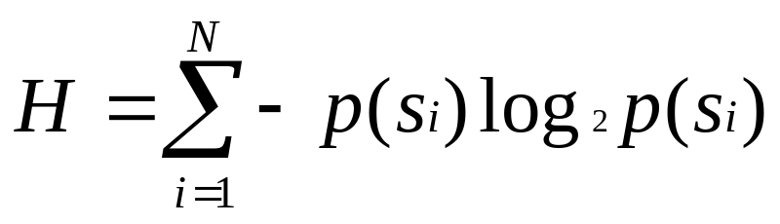
Entropy (Theoretical Limit)
= -.25 * log₂ .25 +
-.30 * log₂ .30 +
-.12 * log₂ .12 +
-.15 * log₂ .15 +
-.18 * log₂ .18
H = 2.24 bits
Symbol | P(S) | Code
A | 0.25 | 01
B | 0.30 | 11
C | 0.12 | 100
D | 0.15 | 101
E | 0.18 | 00
Notes:
ORCHID Research Group
Department of Computer Science, University of Illinois at Urbana-Champaign

Slide 14
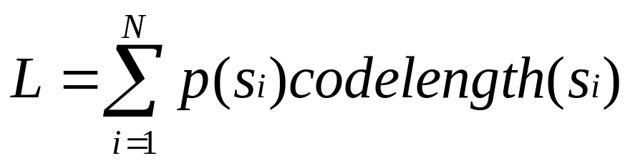
Average Codeword Length
= .25(2) +
.30(2) +
.12(3) +
.15(3) +
.18(2)
L = 2.27 bits
Symbol | P(S) | Code
A | 0.25 | 01
B | 0.30 | 11
C | 0.12 | 100
D | 0.15 | 101
E | 0.18 | 00
Notes:
ORCHID Research Group
Department of Computer Science, University of Illinois at Urbana-Champaign

Slide 15
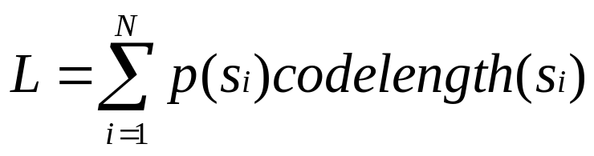
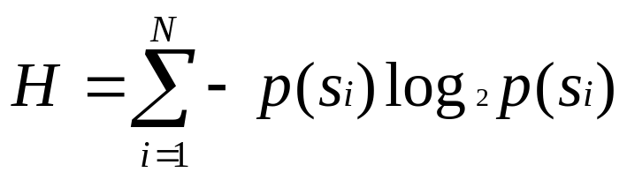
Code Length Relative to Entropy
Huffman reaches entropy limit when all probabilities are negative powers of 2
  i.e., 1/2; 1/4; 1/8; 1/16; etc.
H <= Code Length <= H + 1
CS 414 - Spring 2011
Notes:
ORCHID Research Group
Department of Computer Science, University of Illinois at Urbana-Champaign

Slide 16
Example
H = -.01*log₂.01 +
-.99*log₂.99
= .08
L = .01(1) +
.99(1)
= 1
Symbol | P(S) | Code
A | 0.01 | 1
B | 0.99 | 0
CS 414 - Spring 2011
Notes:
ORCHID Research Group
Department of Computer Science, University of Illinois at Urbana-Champaign

Slide 17
Group Exercise
Symbol (S) | P(S)
A | 0.1
B | 0.2
C | 0.4
D | 0.2
E | 0.1
Compute Entropy (H)
Build Huffman tree
Compute average
code length
Code “BCCADE”
CS 414 - Spring 2011
Notes:
ORCHID Research Group
Department of Computer Science, University of Illinois at Urbana-Champaign

Slide 18
Limitations
Diverges from lower limit when probability of a particular symbol becomes high
  always uses an integral number of bits
Must send code book with the data
  lowers overall efficiency
Must determine frequency distribution
  must remain stable over the data set
CS 414 - Spring 2011
Notes:
ORCHID Research Group
Department of Computer Science, University of Illinois at Urbana-Champaign

Slide 19
Arithmetic Coding
Optimal algorithm as Huffman coding wrt compression ratio
Better algorithm than Huffman wrt transmitted amount of information
  Huffman – needs to transmit Huffman tables with compressed data
  Arithmetic – needs to transmit length of encoded string with compressed data
CS 414 - Spring 2011

Slide 20
Arithmetic Coding
Each symbol is coded by considering the prior data
Encoded data must be read from the beginning, there is no random access possible
Each real number (< 1) is represented as binary fraction
  0.5 = 2⁻¹ (binary fraction = 0.1); 0.25 = 2⁻² (binary fraction = 0.01), 0.625 = 0.5+0.125 (binary fraction = 0.101) ….
CS 414 - Spring 2011

Slide 21
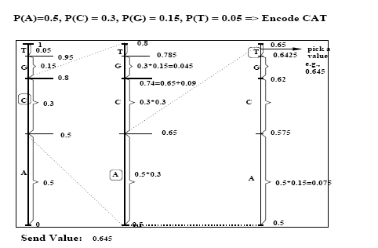
CS 414 - Spring 2011

Slide 22
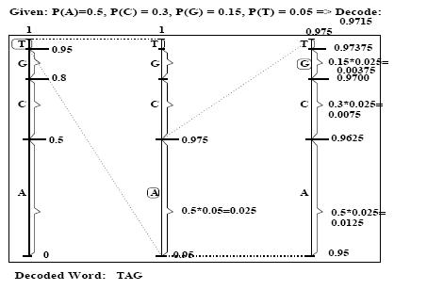
CS 414 - Spring 2011

Slide 23
Adaptive Encoding (Adaptive Huffman)
Huffman code change according to usage of new words and new probabilities can be assigned to individual letters
If Huffman tables adapt, they must be transmitted to receiver side
CS 414 - Spring 2011

Slide 24
Adaptive Huffman Coding Example
Symbol | Code | Original probabilities
A | 001 | P(A) = 0.16
B | 1 | P(B) = 0.51
C | 011 | P( C) = 0.09
D | 000 | P(D) = 0.13
E | 010 | P(E) = 0.11
Symbol | Code | New Probabilities (based on new word BACAAB)
A | 1 | P(A) = 0.5
B | 01 | P(B) = 1/3
C | 001 | P(C ) = 1/6
D | 0000 | P(D) = 0
E | 0001 | P(E) = 0
CS 414 - Spring 2011

Slide 25
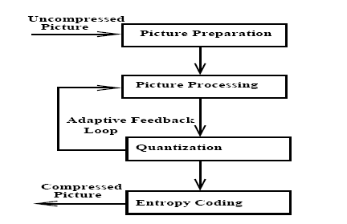
Hybrid Coding (Usage of RLE/Huffman, Arithmetic Coding)
RLE, Huffman
Arithmetic
Coding
CS 414 - Spring 2011

Slide 26
Picture Preparation
Generation of appropriate digital representation
Image division into 8x8 blocks
Fix number of bits per pixel (first level quantization – mapping from real numbers to bit representation)
CS 414 - Spring 2011

Slide 27
Other Compression Steps
Picture processing (Source Coding)
  Transformation from time to frequency domain (e.g., use Discrete Cosine Transform)
  Motion vector computation in video
Quantization
  Reduction of precision, e.g., cut least significant bits
  Quantization matrix, quantization values
Entropy Coding
  Huffman Coding + RLE
CS 414 - Spring 2011

Slide 28
Audio Compression and Formats (Hybrid Coding Schemes)
MPEG-3
ADPCM
u-Law
Real Audio
Windows Media (.wma)
Sun (.au)
Apple (.aif)
Microsoft (.wav)
CS 414 - Spring 2011
Notes:
ORCHID Research Group
Department of Computer Science, University of Illinois at Urbana-Champaign

Slide 29
Image Compression and Formats
RLE
Huffman
LZW
GIF
JPEG / JPEG-2000 (Hybrid Coding)
Fractals
TIFF, PICT, BMP, etc.
CS 414 - Spring 2011
Notes:
ORCHID Research Group
Department of Computer Science, University of Illinois at Urbana-Champaign

Slide 30
Video Compression and Formats (Hybrid Coding Schemes)
H.261/H.263/H.264
Cinepak (early 1992 Apple’s video codec in Quick-time video suite)
Sorensen (Sorenson Media, used in Quick-time and Macromedia flash)
Indeo (early 1992 Intel video codec)
Real Video (1997 RealNetworks)
MPEG-1, MPEG-2, MPEG-4, etc.
QuickTime, AVI, WMV (Windows Media Video)
CS 414 - Spring 2011
Notes:
ORCHID Research Group
Department of Computer Science, University of Illinois at Urbana-Champaign

Slide 31
Summary
Important Lossless (Entropy) Coders
  RLE, Huffman Coding and Arithmetic Coding
Important Lossy (Source ) Coders
  Quantization
    Differential PCM (DPCM) – calculate difference from previous values – one has fewer values to encode
    Loss occurs during quantization of sample values, hence loss on difference precision occurs as well
CS 414 - Spring 2011

Slide 32
Solution
Symbol | P(S) | Code
A | 0.1 | 100
B | 0.2 | 110
C | 0.4 | 0
D | 0.2 | 111
E | 0.1 | 101
Compute Entropy (H)
  H = 2.1 bits
Build Huffman tree
Compute code length
  L = 2.2 bits
Code “BCCADE” => 11000100111101
CS 414 - Spring 2011
Notes:
ORCHID Research Group
Department of Computer Science, University of Illinois at Urbana-Champaign

